Slide 1
HR MANAGEMENT SYSTEM
160119737006 160119737022
IT-1 (2/4)

Slide 2




TABLE OF CONTENTS
01
04
Introduction
Functions and Results
02
05
Tools
Limitations
03
06
Future Scope
Modules

Slide 3
INTRODUCTION
The project is used to maintain efficiently the HR department schedule of any type of company. In larger organization, employees are large. At that time this project is useful and helpful. HR Management system is not only becomes a desire of the company but it becomes the need of the company. The User(including HR) gets into the system using admin name and a password.

Slide 4
ADVANTAGES
Easy access to the data
The new system is more user-friendly, reliable and flexible.
Data alteration is easy.
Maintenance of the project is easy.
Reduced manual work.
Timely Report generation

Slide 5
TOOLS
Front End Tools:
IDE : NetBeans (Java)
Back End Tools:
Text Editor : Atom (PHP,HTML,CSS)
Server : XAMPP

Slide 6
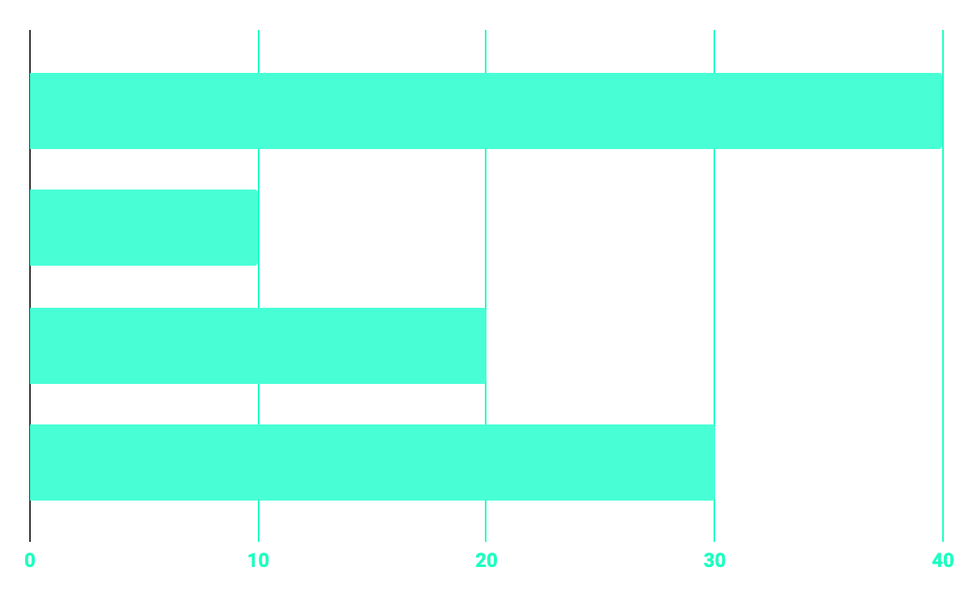
CONTRIBUTION
40%
20%
RESEARCH
10%
30%
DATABASE
WEB DESIGN
PROGRAMMING

Slide 7
MODULES
EMPLOYEE MODULE
HR MODULE
PAYROLL MODULE
ATTENDANCE MODULE
PROJECT MODULE

Slide 8
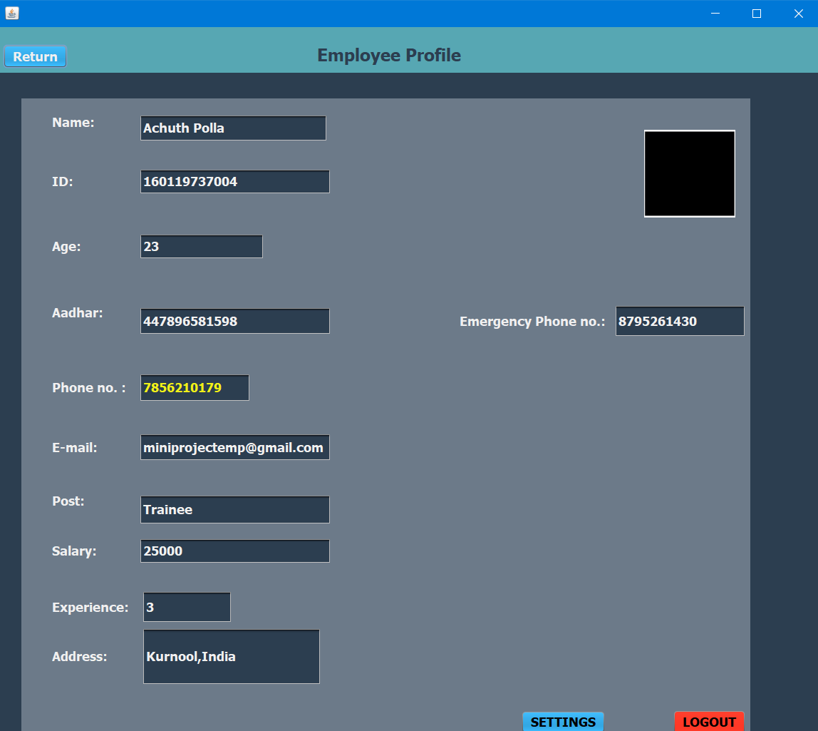
FUNCTIONS AND RESULTS
EMPLOYEE MODULE
Employee Details module is used to maintain the employee’s details such as Modifying the existing data, Uploading project reports , Searching employee and Communicating with other employees.
The employee details contains three kind of information.
Personal Information
Employee Information
Chatting application

Slide 9
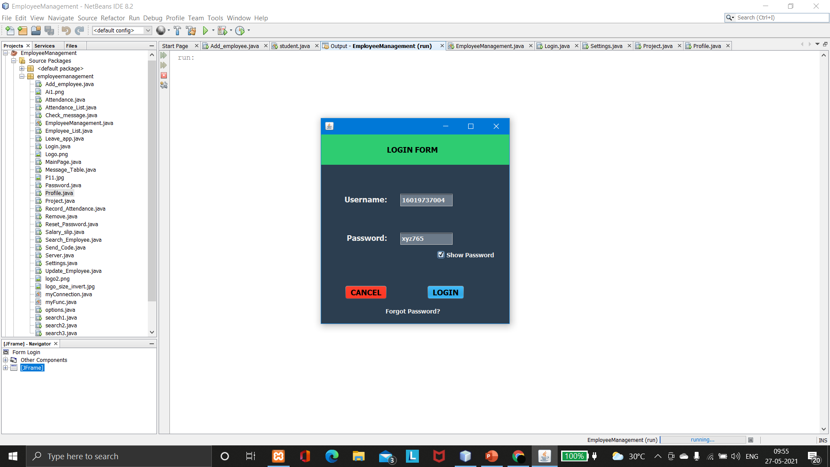
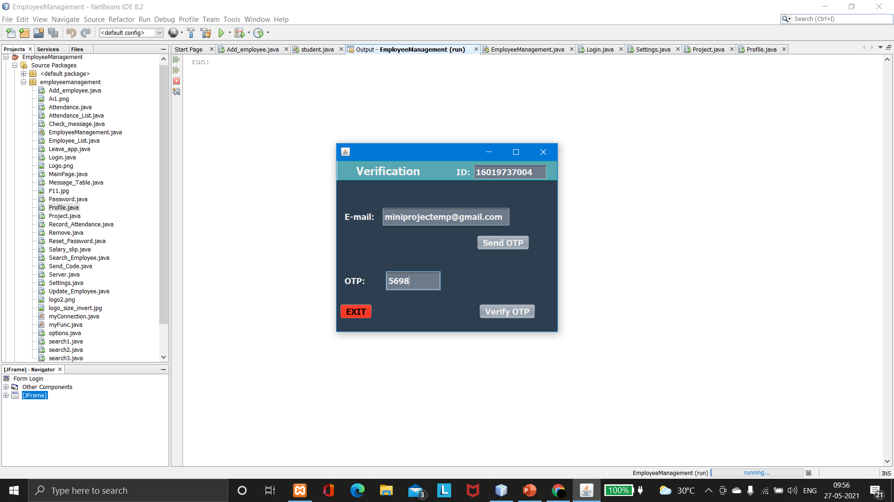
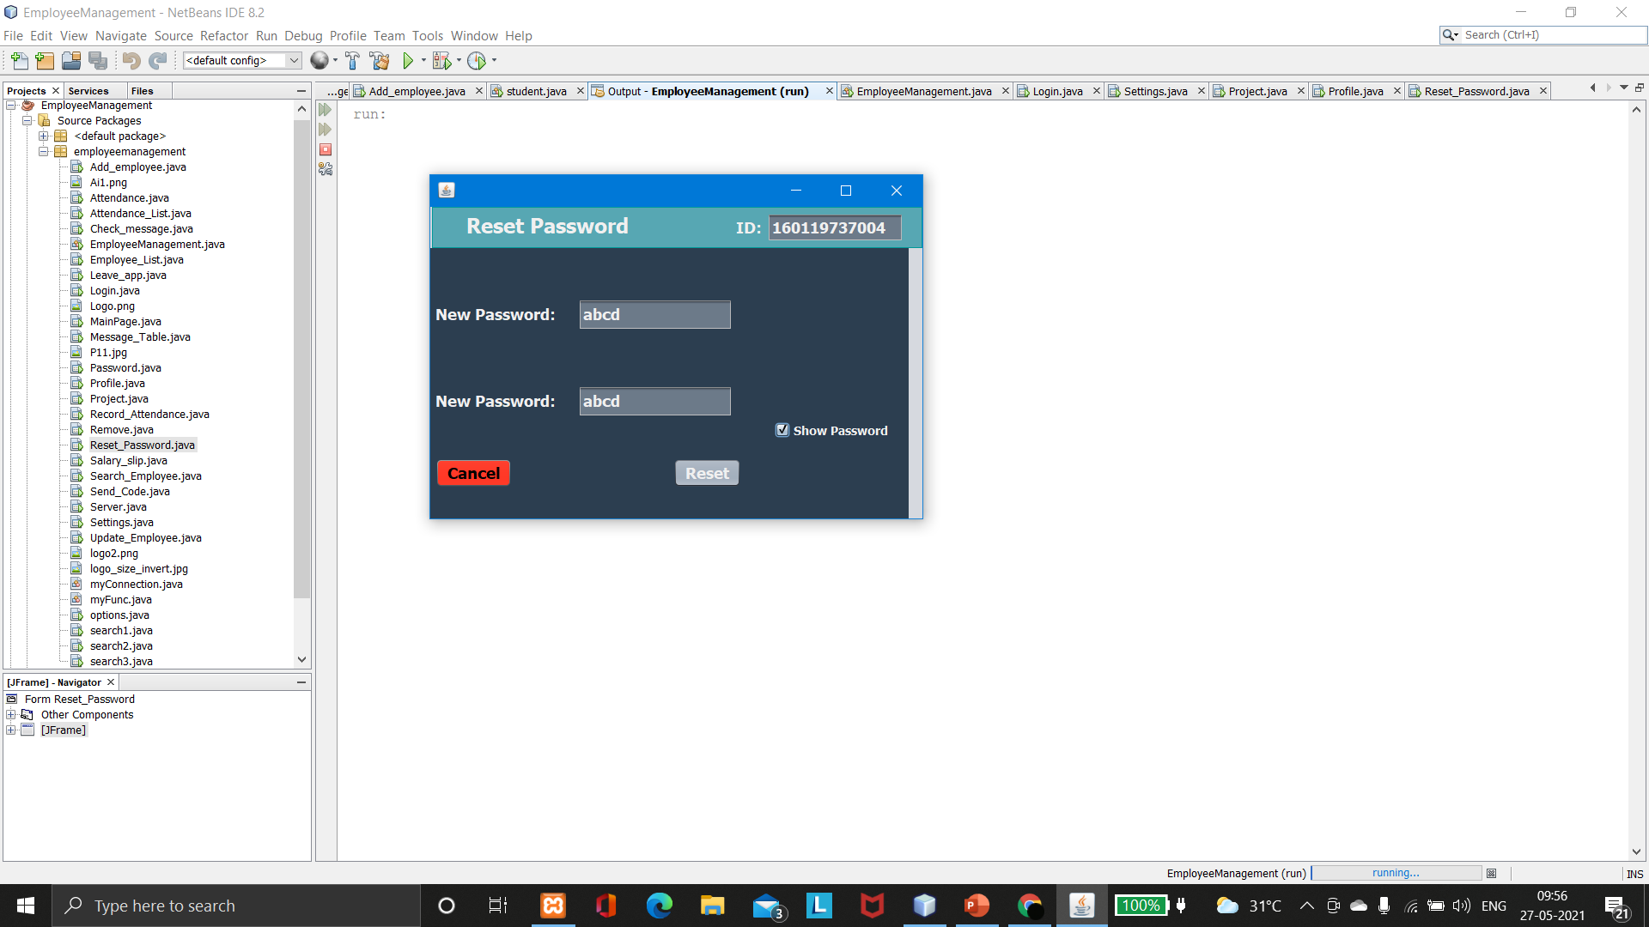
EMPLOYEE MODULE
Login Page:

Slide 10
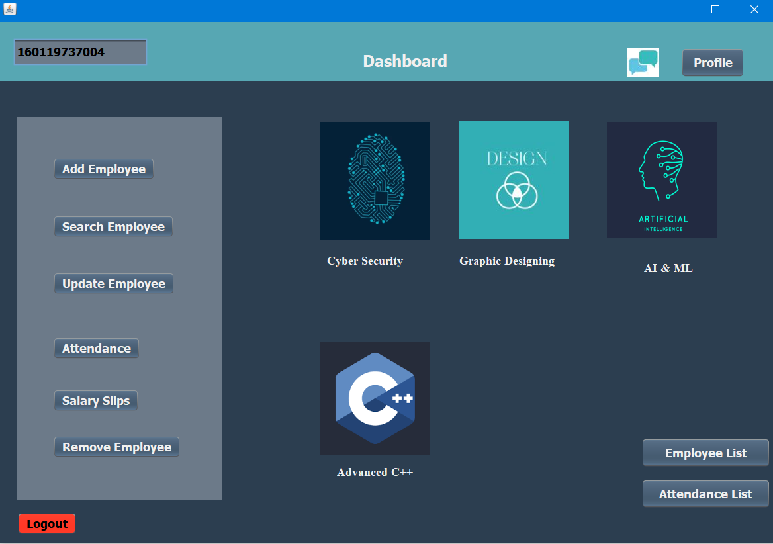
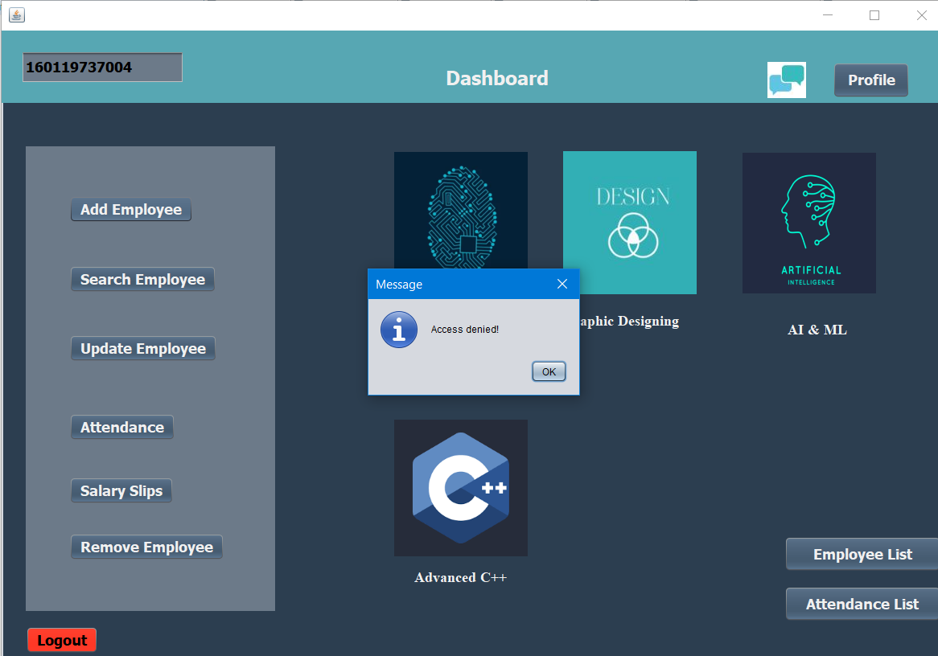
EMPLOYEE MODULE

Slide 11
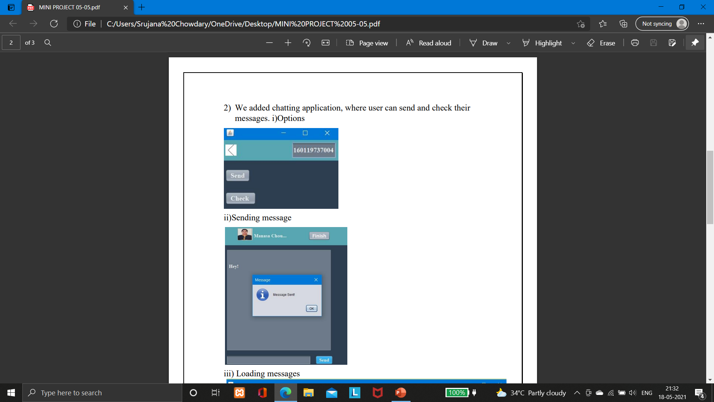
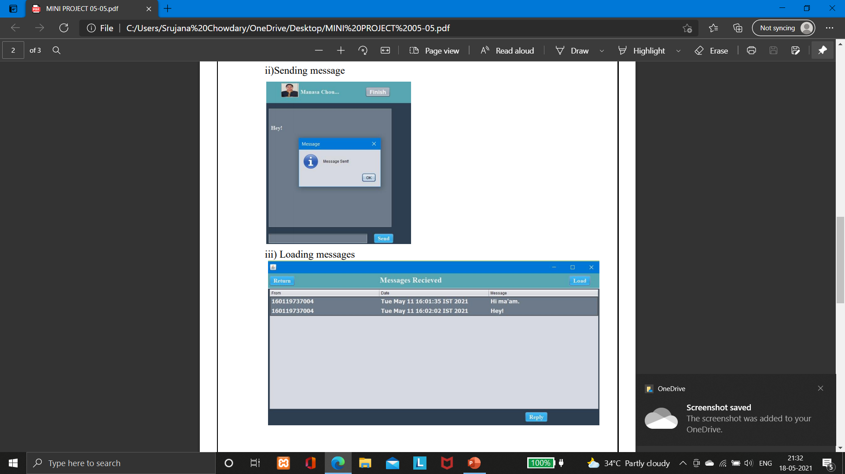
EMPLOYEE MODULE

Slide 12
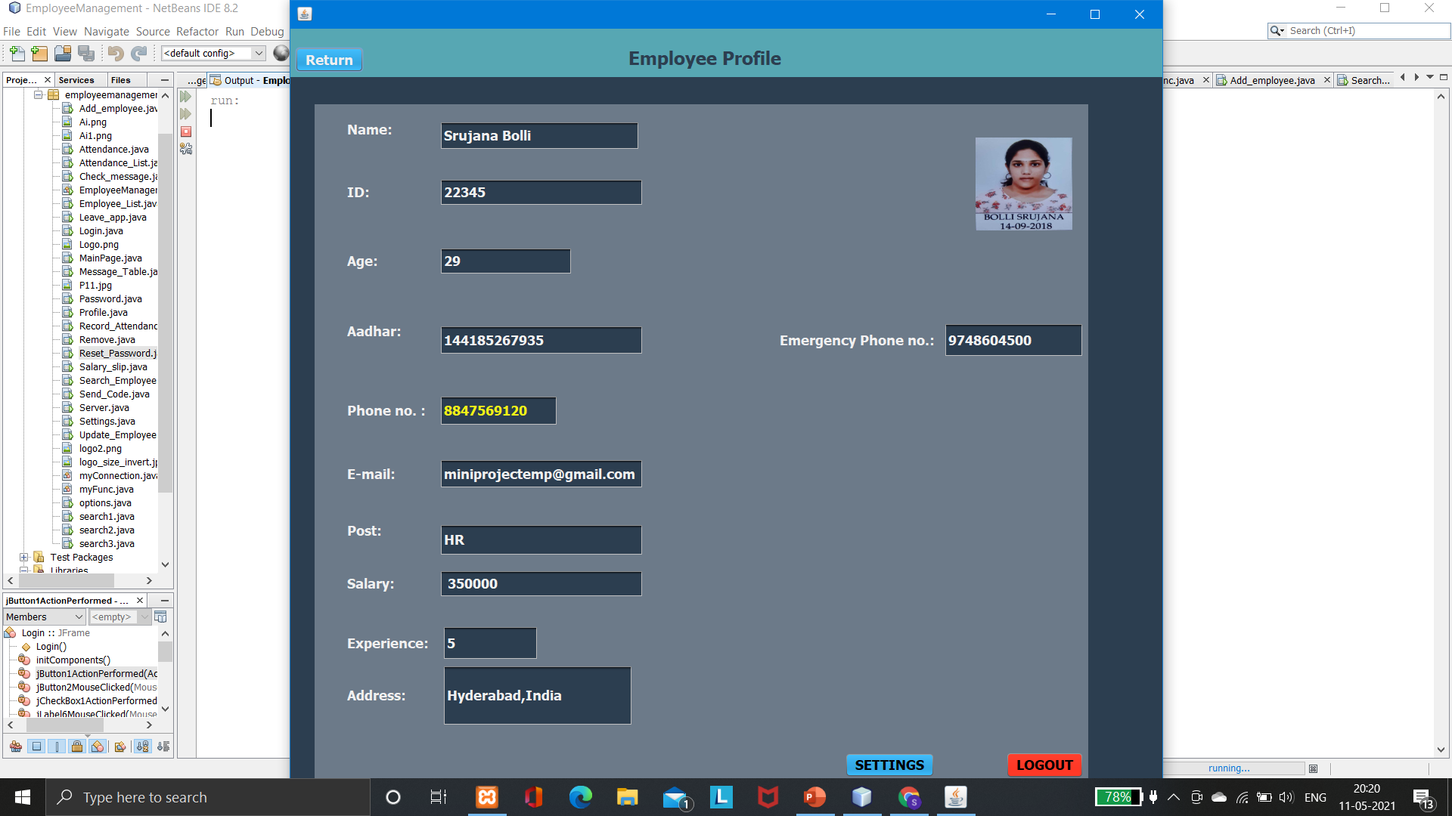
HR MODULE
HR module is used to maintain the employee’s details such as Adding, Deleting, Modifying the existing data, Searching employee and Communicating with other employees.
The HR details contains three kind of information.
Personal Information
Employee Information
List

Slide 13
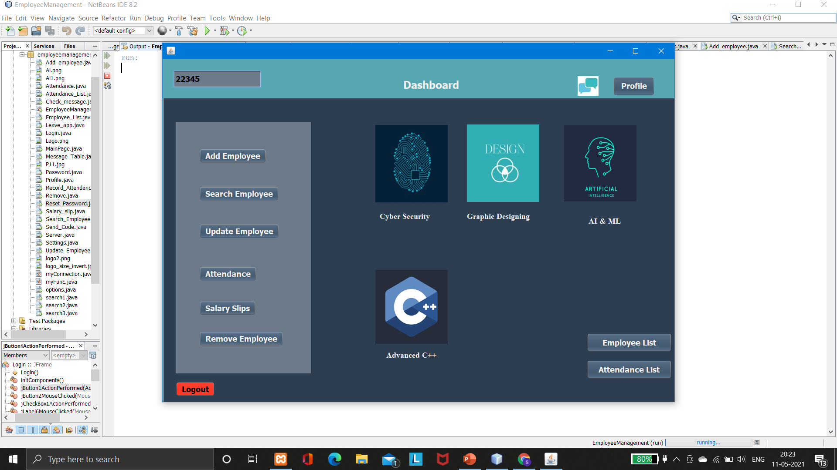
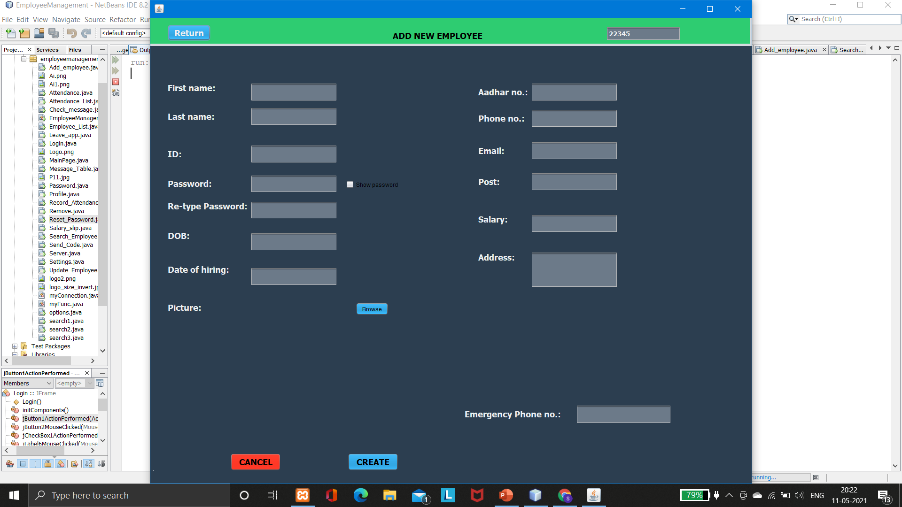
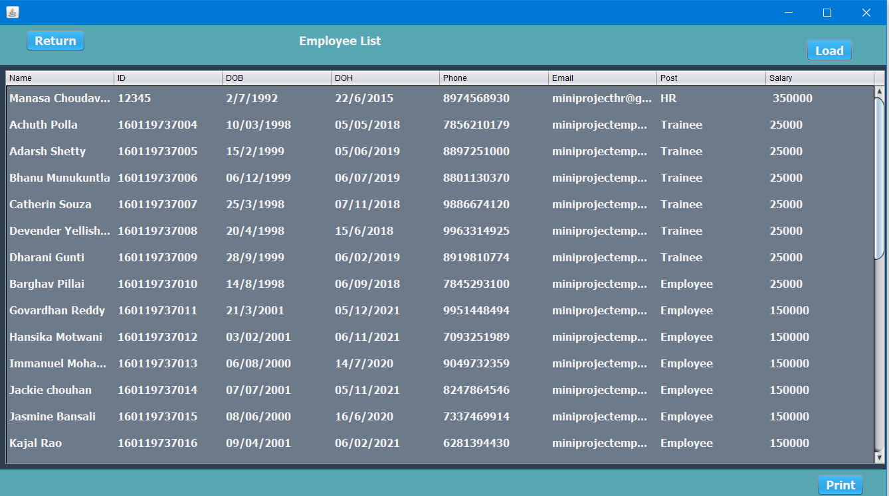
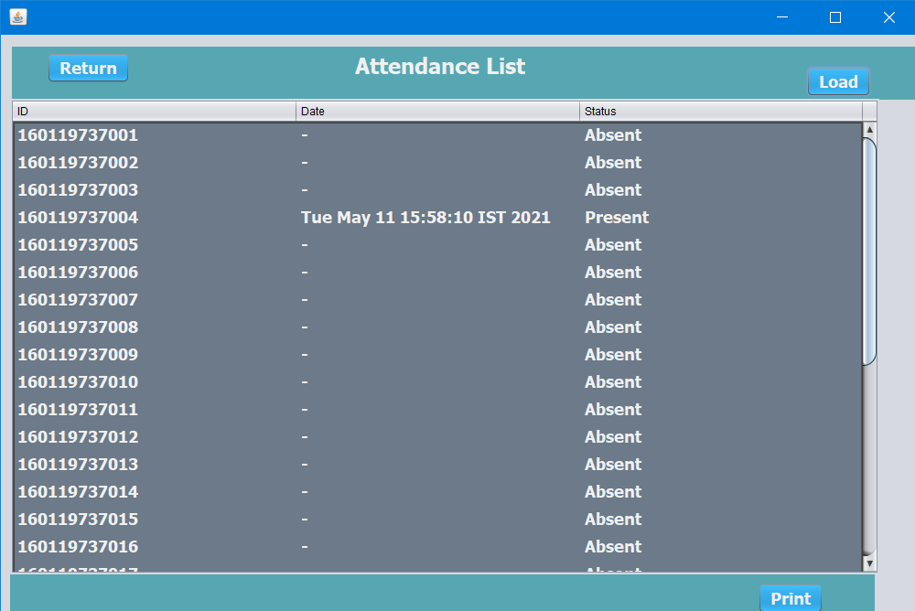
HR MODULE

Slide 14
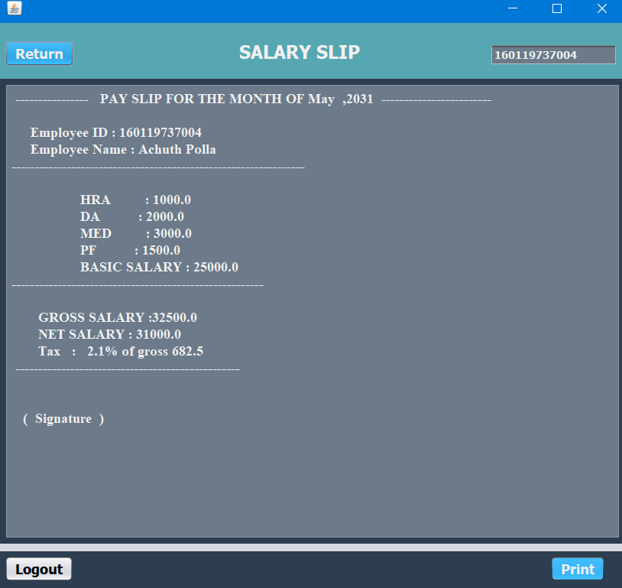
PAYROLL MODULE
In the payroll module, it consists of the information about the employee salary details such as basic pay, allowances, deductions and calculate the gross pay and net pay from the given allowances and deductions. Employee can print their salary slip through print button.

Slide 15
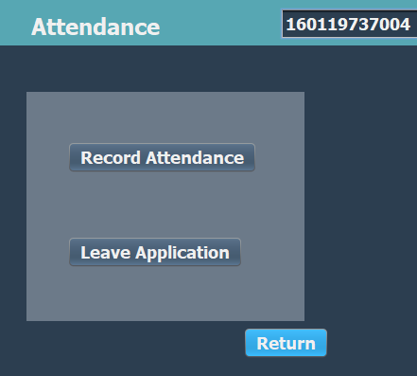
ATTENDANCE MODULE
In the Attendance module, it consists of two functions:
Submit Attendance: In Submit attendance, the employee’s can submit their attendance and the time will be recorded.
Leave Application:In Leave Application, it contains the information about the employees leave details. They can choose a date and type out their request in the given space. The mail will be sent.

Slide 16
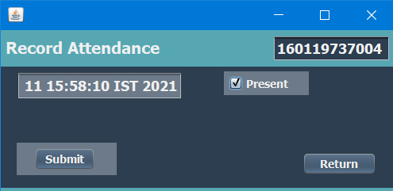
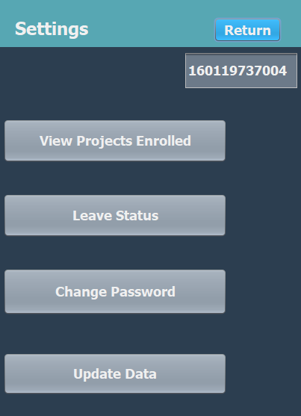
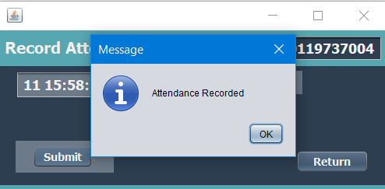
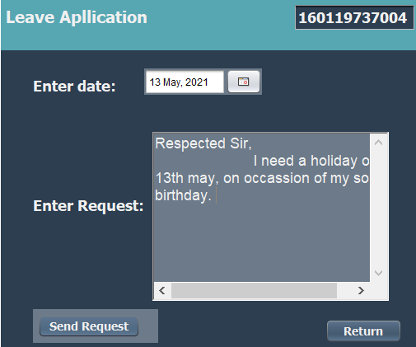
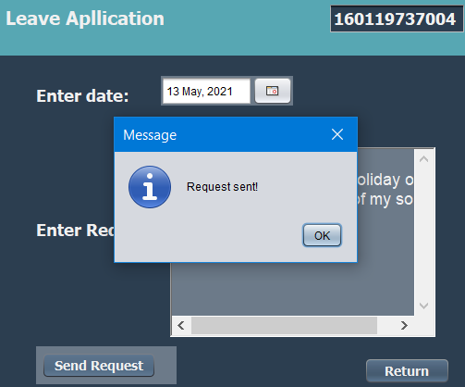
ATTENDANCE MODULE

Slide 17
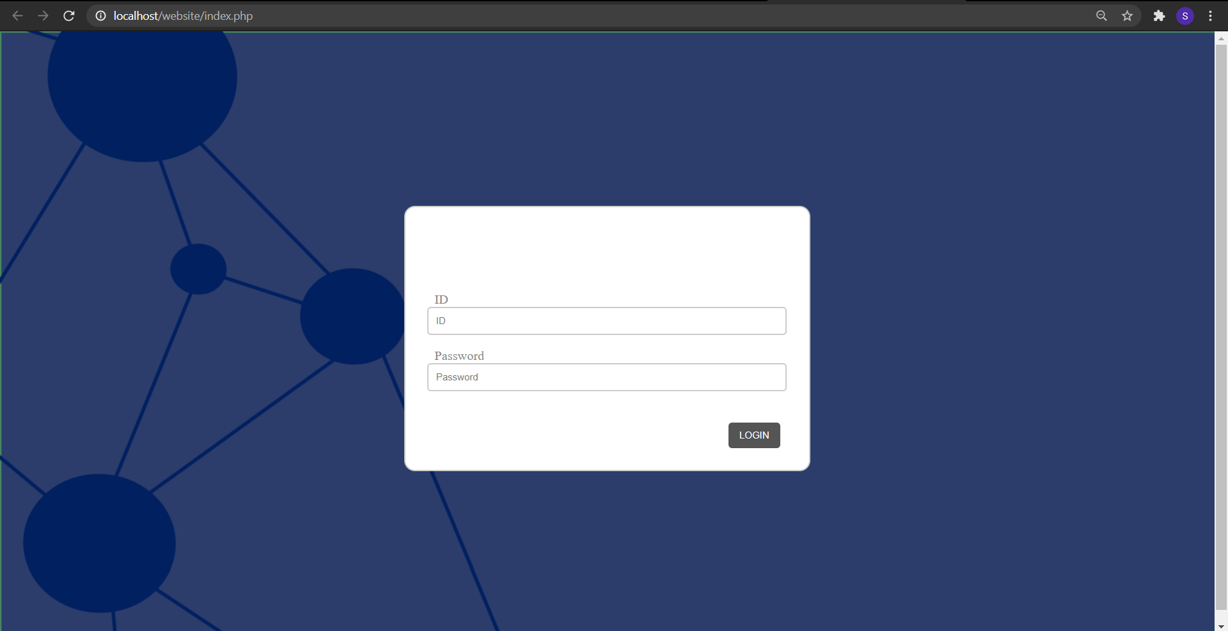
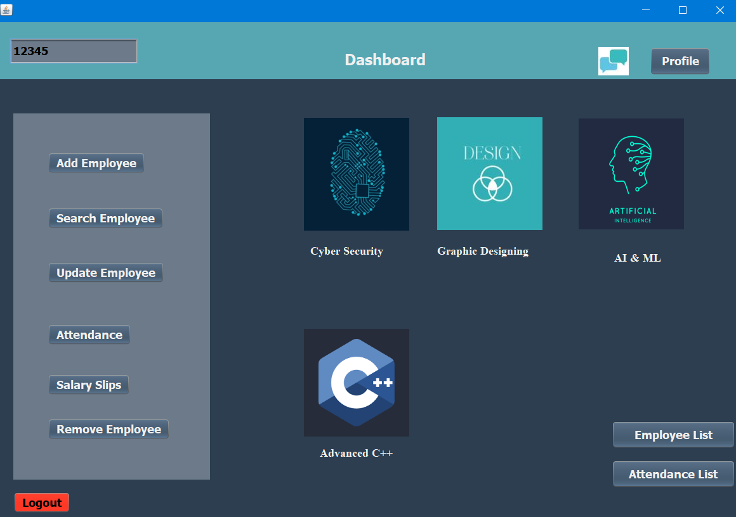
PROJECT MODULE
In Project module, employee should upload their weekly report on respective project.
HR can access them and evaluate , and provide CIE based on their report.
This module is used to monitor the employees, their work performance and the involvement of them in the organization.
Employee Projects:
1.Cyber Security
2.Graphic Designing
3.AI & ML
Trainee Projects:
1.Advanced C++

Slide 18
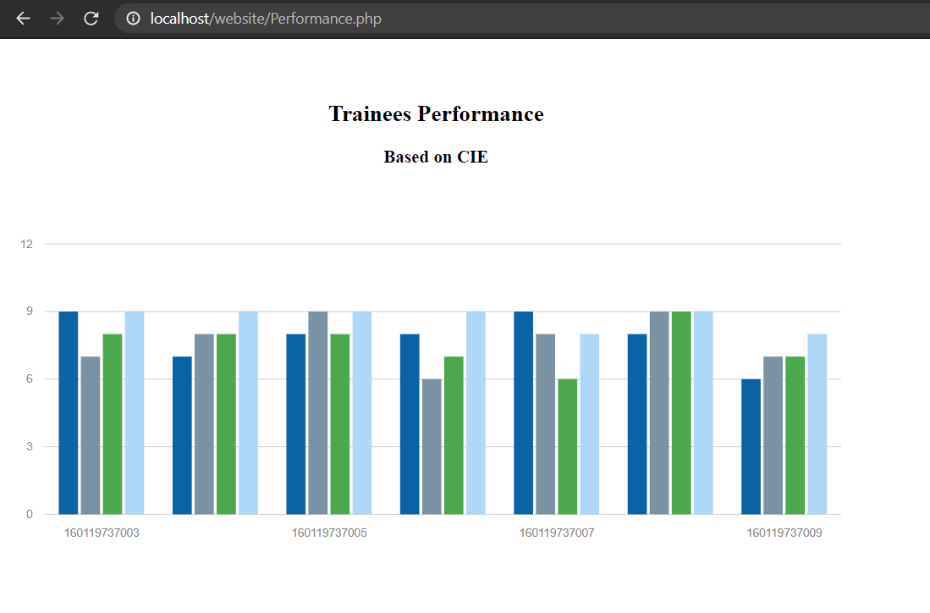
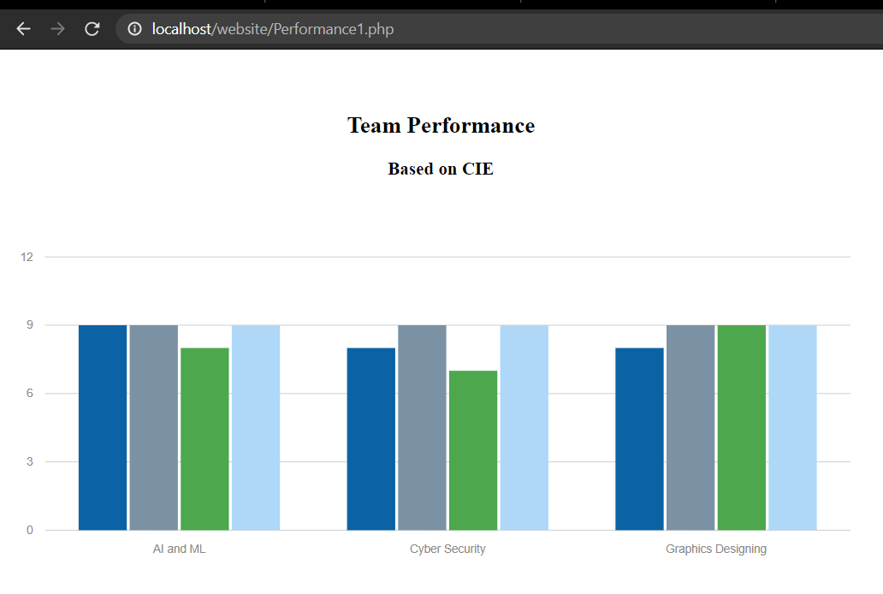
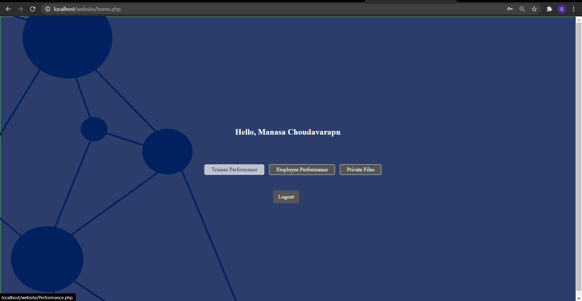
PROJECT MODULE

Slide 19
LIMITATIONS
Employee cannot add, delete or modify other employee’s data.
Employee’s image has to be in form of .png , .jpg or .jpeg only.
Employee and Attendance List are only accessed by HR.
Employees cannot access Trainees project and vice versa.
Attendance have to be recorded manually by every employee.
Once a message is sent, it cannot be deleted.

Slide 20
FUTURE SCOPE
This application can be easily implemented under various situations. We can add new features as and when require. Reusability is possible. Reusable software reduces design , coding and testing cost amortizing effort over several designs and also reducing the amount of coding simplifies understanding, increases likelihood of the code . There is flexibility in all the modules.
1

Slide 21

THANK YOU
THANK YOU

